Slide 1


DARK Psychology How to Detect and Defend
Anoosha Rehan
Lecturer, FAST NUCES CFD
This Photo by Unknown Author is licensed under CC BY-NC-ND

Slide 2
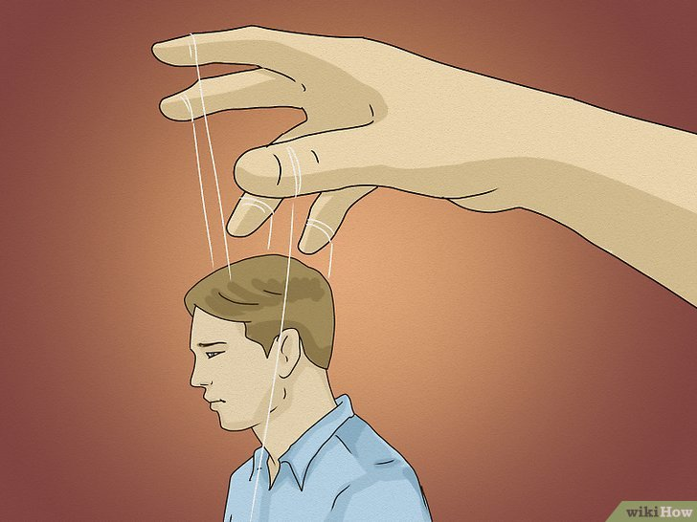
WHAT IS DARK PSYCHOLOGY?
“It cannot be seen, cannot be felt, cannot be heard, cannot be smelt; It hides behind stars and under hills and empty holes; it fills; It comes first and follows after. Ends life, kills laughter”. (Williams, J. W. (2020). Dark Psychology)
This Photo by Unknown Author is licensed under CC BY-NC-ND

Slide 3

WHAT IS DARK PSYCHOLOGY?
Dark Psychology, as the name suggests, delves into the darker aspects of human behavior and the mind. It’s a study of how people use their knowledge of psychology to manipulate, control, and influence others for their own gain, often without the victim’s awareness.
Think of a scenario where a salesperson uses flattery and emotional manipulation to convince you to buy something you don’t need. You leave the store wondering why you bought it—this is a mild form of dark psychology in action.
This Photo by Unknown Author is licensed under CC BY-NC-ND

Slide 4

ANALYZING DARK PSYCHOLOGY
Common Tactics:
MANIPULATION
In plain terms, to manipulate someone is to control or influence that person cleverly or unscrupulously. Like it or not, we have all manipulated a person or a situation for a desirable outcome.
Example: A colleague might manipulate you into covering their shift by saying they have a family emergency, even if they don’t. You feel obligated, but they just wanted the day off.
This Photo by Unknown Author is licensed under CC BY-NC-ND

Slide 5

ANALYZING DARK PSYCHOLOGY
Common Tactics:
Lying
One of the most common tactics employed by manipulators is
lying. They are adept at coming up with grand stories that have no real bearings on the truth.
Example: Think of someone who constantly invents stories about their achievements to appear more successful. Their goal is to make you feel inferior or to gain your admiration.
This Photo by Unknown Author is licensed under CC BY-NC-ND

Slide 6

ANALYZING DARK PSYCHOLOGY
Common Tactics:
Guilt tripping and shaming
When confronted for something they have done wrong they would instantly deny it and then promptly turn the tables around by making you feel bad for questioning them in the first place.
Example: You confront a friend about canceling plans last minute, and they reply, ‘I didn’t realize spending time with me was such a burden for you,’ leaving you feeling guilty instead of holding them accountable.
This Photo by Unknown Author is licensed under CC BY-NC-ND

Slide 7
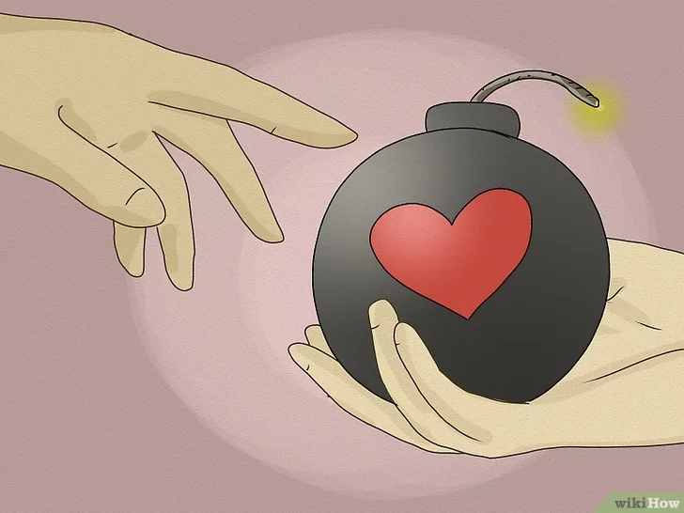
ANALYZING DARK PSYCHOLOGY
Common Tactics:
DECEPTION (🚨 Red Flags)
Deception is defined as the act of hiding the truth, especially to gain an advantage.
Example: A partner may hide their financial troubles, presenting a false image of stability, only to reveal the truth when it’s too late to back out of a joint commitment.
This Photo by Unknown Author is licensed under CC BY-NC-ND

Slide 8
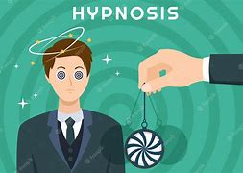
ANALYZING DARK PSYCHOLOGY
Common Tactics:
HYPNOSIS
The key elements in hypnosis are the power of suggestion and the repetitive use of words that resonates deeply.
Example: Advertisers frequently use this technique. Hearing slogans repeatedly—such as ‘Because you’re worth it’—shapes how you view yourself and influences purchasing decisions.
A friend might constantly tell you, ‘You’re always so forgetful,’ until you start believing it, even though it may not be true.
This Photo by Unknown Author is licensed under CC BY-NC-ND

Slide 9
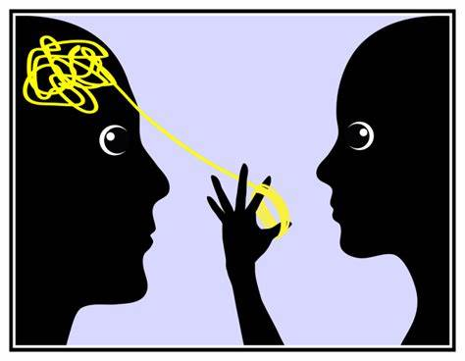
ANALYZING DARK PSYCHOLOGY
Common Tactics:
Gaslighting
Gaslighting refers to a form of manipulation where a person tries to convince someone that they’re going crazy, or that their memory is failing them to get them to believe something beneficial for the gas-lighter.
Example: Imagine your partner denies ever saying something, even though you clearly remember it. Over time, they make you question your memory, and you start to believe them, doubting your own experiences.
This Photo by Unknown Author is licensed under CC BY-NC-ND

Slide 10
Tactic | Definition | How It Works | Example | Effect on Victim
Manipulation | Controlling or influencing a person’s behavior cleverly or dishonestly for personal gain. | Subtle persuasion to guide someone into doing something that benefits the manipulator, often without awareness. | A boss downplays an employee's contribution to discourage them from asking for a raise. | Victim may feel guilty, confused, or obligated to comply with the manipulator's desires.
Lying | Telling falsehoods or creating fabricated stories to mislead others. | The manipulator creates false narratives to cover the truth or paint themselves in a favorable light. | A friend lies about where they were to avoid conflict but continuously spins more stories to cover the initial lie. | The victim’s trust is eroded, and they may become unsure of what is true.
Guilt Tripping/Shaming | Making someone feel guilty or ashamed for questioning or confronting behavior. | The manipulator shifts the blame onto the victim, making them feel responsible or bad for raising legitimate issues. | A colleague says, "If you really cared about the team, you'd work overtime," making you feel guilty for not wanting to work extra. | Victim feels guilty or ashamed and often ends up complying to avoid further guilt or conflict.
Deception | Concealing or distorting the truth to gain an advantage. | The manipulator omits or distorts information to influence the victim’s understanding of a situation. | A partner hides financial issues and only reveals them after a major financial commitment has been made. | Victim is misled, often resulting in poor decisions made on incomplete or false information.
Gaslighting | Manipulating someone to question their reality or sanity. | The manipulator denies events, distorts facts, or manipulates situations to make the victim doubt their own memory. | A spouse denies saying something that the partner clearly remembers, causing the partner to question their memory and reality. | Victim experiences confusion, self-doubt, and a weakened sense of self, becoming dependent on the manipulator's version of reality.
Hypnosis | Influencing someone’s thoughts and behaviors using the power of suggestion and repetition. | Through repeated exposure to certain phrases or ideas, the manipulator implants thoughts or beliefs into the victim’s mind. | Advertisers use repetitive slogans like “Just Do It” to shape behavior and create an emotional connection to a product. | Victim is subtly influenced over time, often without realizing their thoughts or decisions have been manipulated.

Slide 11

KEY AREAS IN OUR LIVES THAT MAKE US VULNERABLE TO DARK PSYCHOLOGY
LOVE AND RELATIONSHIPS
BLIND FAITH AND RELIGIOUS BELIEFS
SOCIAL CONDITIONING
AMBITION AND PERSONAL ASPIRATIONS
EMOTIONAL SCARS
This Photo by Unknown Author is licensed under CC BY-NC-ND

Slide 12

Avoiding Dark Triad Behavior
IGNORE THE LIES THAT OTHERS TELL US: You Matter 🌈
DON’T COVER UP Positive Self-Talk: Be Your Own Cheerleader📣
FORGIVE YOURSELF 🔒
Trust Your Intuition: Listen to Your Gut 🤔
This Photo by Unknown Author is licensed under CC BY-NC-ND

